Slide 1
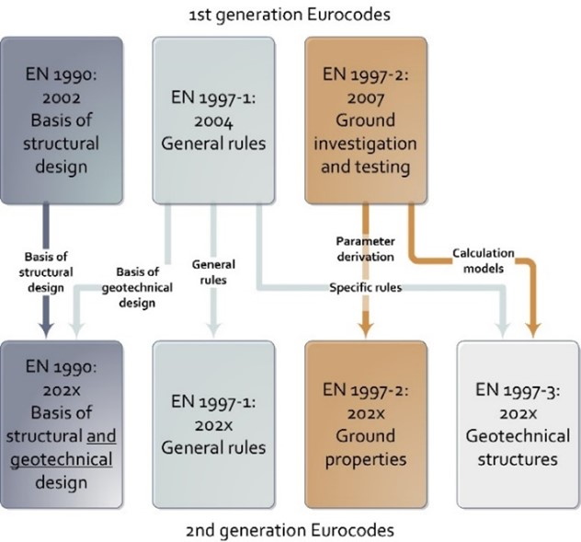
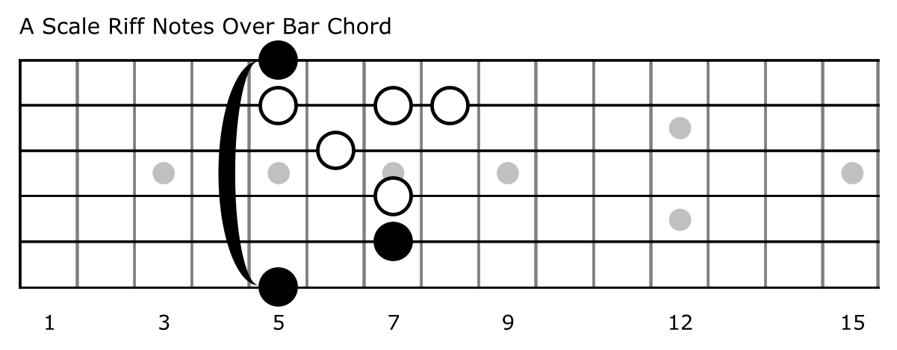
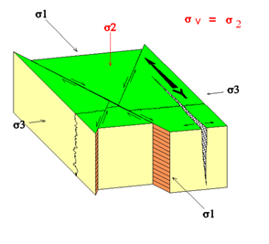
Title of the paper (Arial 48 point size, left aligned, black)
Author1 1), Author2 2), Author3 3) (Arial, 32 point size, left aligned, black; please do not quote any title (e.g., Prof., Dr.) in this field; do not abbreviate names, especially the last name)
1) AffiliationAuthor1, CityAuthor1, CountryAuthor1 (Arial, 24 point size, left aligned, black; please do not quote any title (e.g., Prof., Dr.) in this field)
2) AffiliationAuthor2, CityAuthor2, CountryAuthor2
3) AffiliationAuthor3, CityAuthor3, CountryAuthor3
Heading (Arial, bold, 36 point size, justified alignment, black)
The body text must be in Arial. Font colour is black. The font size is 32 points. Justified alignment. Paragraphs are indented 10 mm. Please do not use blank lines between paragraphs, or between the body text and headings. Do not underline any text or use bold style except to indicate vectors (mathematics). All elements (e.g., paragraphs, tables, figures) placed within the three columns of the body text must fit exactly into the type area of 245.2 mm of width each column. Please use just one level for the headings. Otherwise, you will loose24,5 too much space.
Text within figures must be in English and with respect to readability at least 24 points font size. Figures, photographs, graphs, etc. can be in colour. To ensure a good quality print provide figures with at least 300 dpi resolution, in the best case vector graphics (*.eps, *.png, vectorized *.pdf). Please use SI units at all elements.
Text within tables must be in English and with respect to readability at least 24 points font size. Avoid the use of vertical lines or double lines. Use SI units and keep tables as simple as possible to avoid visual discomfort. Indicate the meaning of abbreviations if used.
The citation style for the contributions of Eurock 2024 is based on the APA citation style.
Equations are embedded as Microsoft equation editor objects:
To the right of the equation, the equation number must be placed in parentheses. Define the symbols used in the equation in the paragraph before or after the equation. Avoid too long equations, rather refer to your Eurock 2024 paper.
At the end of the paper, list the references in alphabetical order underneath the heading 'References'. Please make sure you have listed
al references used in the poster and do not list a reference that you did not use. If several works by the same author are cited, the entries should be in chronological order. If the works have the same year of publication, use letters to distinguish them.
Introduction
Proin pellentesque congue quam, eu facilisis sem sollicitudin ac. Maecenas eu augue leo. Aliquam a elementum orci. Etiam fermentum maximus tellus, in rhoncus eros iaculis vel. Suspendisse eu dolor nec justo varius pulvinar sit amet a libero. Sed laoreet ut ligula ac egestas. Aliquam porttitor condimentum pulvinar.
Materials and methods
Let’s explore the musical backgrounds, styles, and significant contributions of these legendary guitarists.
We’ll delve into their early careers, influences, and the instruments they used to shape rock history.
Results
In this section, we’ll highlight key achievements and milestones for each artist (see Table 1).
From Jimmy Page’s groundbreaking work with Led Zeppelin to John Fogerty’s timeless hits with Creedence Clearwater Revival, we’ll celebrate their impact.
Discussion
Here, we’ll analyze their musical techniques, songwriting approaches, and the impact of their compositions.
We’ll discuss their influence on subsequent generations of musicians and their enduring legacy.
Conclusion
To encapsulate the findings of this poster, our exploration of the lives of renowned artists Jimmy Page, John Fogerty, and Eddie Van Halen will culminate in an analysis of their enduring legacies. We will examine the ongoing resonance of their artistic contributions among fans globally.
Acknowledgements
This section is not mandatory. Use it only if you want to thank people who have helped you with ideas, technical assistance, data, materials or financing.
References
Boulch, A., Marlet, R., 2016. Deep Learning for Robust Normal Estimation in Unstruc-tured Point Clouds. Computer Graphics Forum 35, 281–290.
Girardeau-Montaut, D., 2023. CloudCompare (version 2.12.4) [GPL software]. Open-Source Project.
ISRM, 1978. International Society for Rock Mechanics Commission on standardization of laboratory and field tests: Suggested methods for the quantitative description of dis-continuities in rock masses. International Journal of Rock Mechanics and Mining Sciences & Geomechanics Abstracts 15, 319–368.
Leica Geosystems AG, 2021. Cyclone 2021.1.2 64-bit.
Leica Geosystems AG, 2011. Leica ScanStation C10 data sheet. Heerbrugg, Switzerland.
Riquelme, A., Abellán, A., Tomás, R., Jaboyedoff, M., 2014a. A new approach for semi-automatic rock mass joints recognition from 3D point clouds. Comput Geosci 68, 38–52.
Figure 3. Another example of a figure. Source: https://eurock2024.com/workshops .
Figure 1. Centre both, figures and figure captions. The figure caption is situated below the figure. The font size is 24 points. Separate the caption text from the numbering by a period (point). Complete the caption text with a period (point). Source: https://www.guitar-chords.org.uk/.
Table 1. Centre the table. Table captions must be left aligned. Place table captions above the table. The font size is 24 points. Separate the caption text from the numbering by a period (point). Complete the caption text with a period (point).
Figure 2. Another example of a figure. Source: https://eurock2024.com/workshops .
Artist | Birth | Best Songs
Jimmy Page | 1944 | Stairway to Heaven
 |  | Whole Lotta Love
John Fogerty | 1945 | Fortunate Son
 |  | Proud Mary
Van Halen | 1955 | Jump
 |  | Panama
(1)
Contact presenting author:
presidencia@corp.realmadrid.com
0034 91 121 00 90

